Slide 1

ECE 477 FINAL REVIEW: TEAM #18
Notes:
Anurag

Slide 2
OUTLINE
Project Overview
Block Diagram
Design Challenges
Individual Contributions
Project Video Demonstration
Questions
Notes:
Anurag

Slide 3
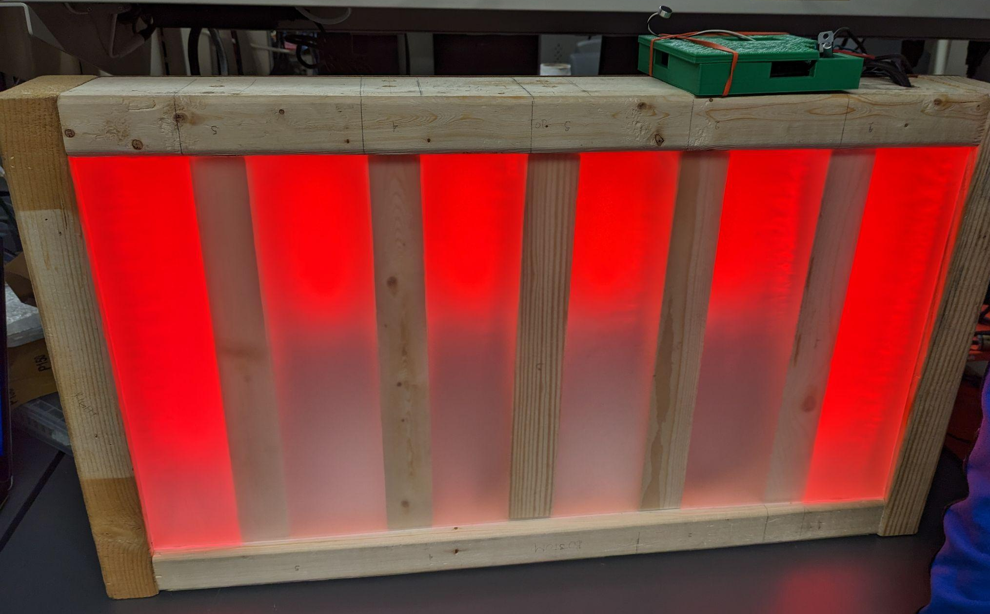
PROJECT OVERVIEW
RDNT is a device that aims to bring a new dimension to the user’s musical experience, whether it be the main attraction of a party, a fresh new feature to a business’s ambiance, or just to use for the enjoyment of listening to one’s favorite songs in a new way. With multiple avenues to play your favorite tunes, full customization of the LED display’s colors, and control through our mobile app, RDNT intends to create a new dynamic to listening to music as seamless and accessible as possible.

Slide 4
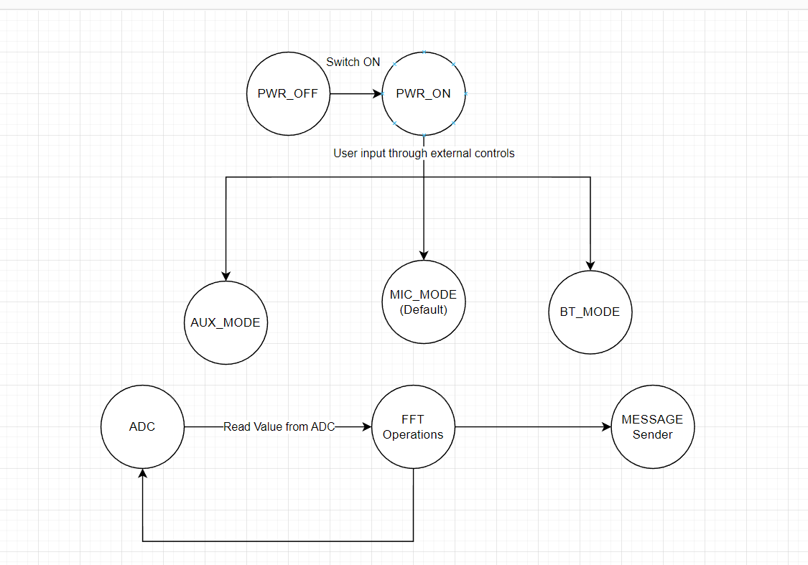
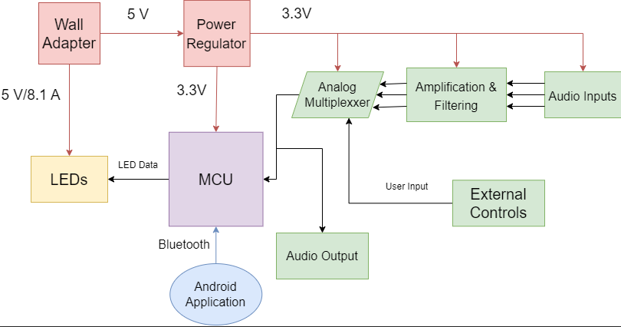
BLOCK DIAGRAM

Slide 5
DESIGN CHALLENGES
Microphone Circuitry
Prototyped 4 different amplifier circuits for refined audio
PCB Design
Had to redesign after mid-semester design review
Power Circuit issues
Accidentally designed circuit with tiny capacitors
FFT Software
Difficult to interpret results
LEDs flickering
Had to learn how multiprocessing works in FreeRTOS

Slide 6
INDIVIDUAL CONTRIBUTIONS
ANURAG NUMBOORI
Software Prototyping
Arduino and ESP-IDF
Final Firmware Version (with Kahaan)
Gaussian Smoothing and ADC Sampling
Audio Circuitry Design and Prototyping
Final Schematic (with Graeme and Avik)
PCB Design (with Avik)
Display Wiring
Keeping the team on track
Notes:
Anurag

Slide 7
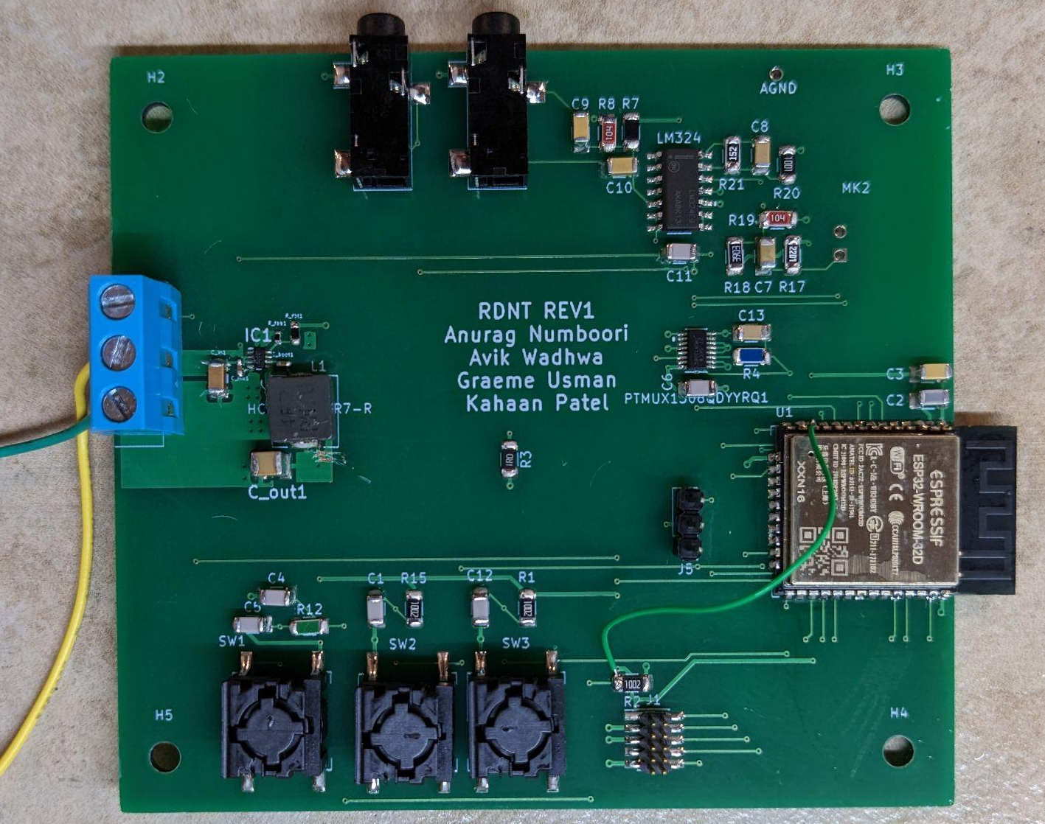
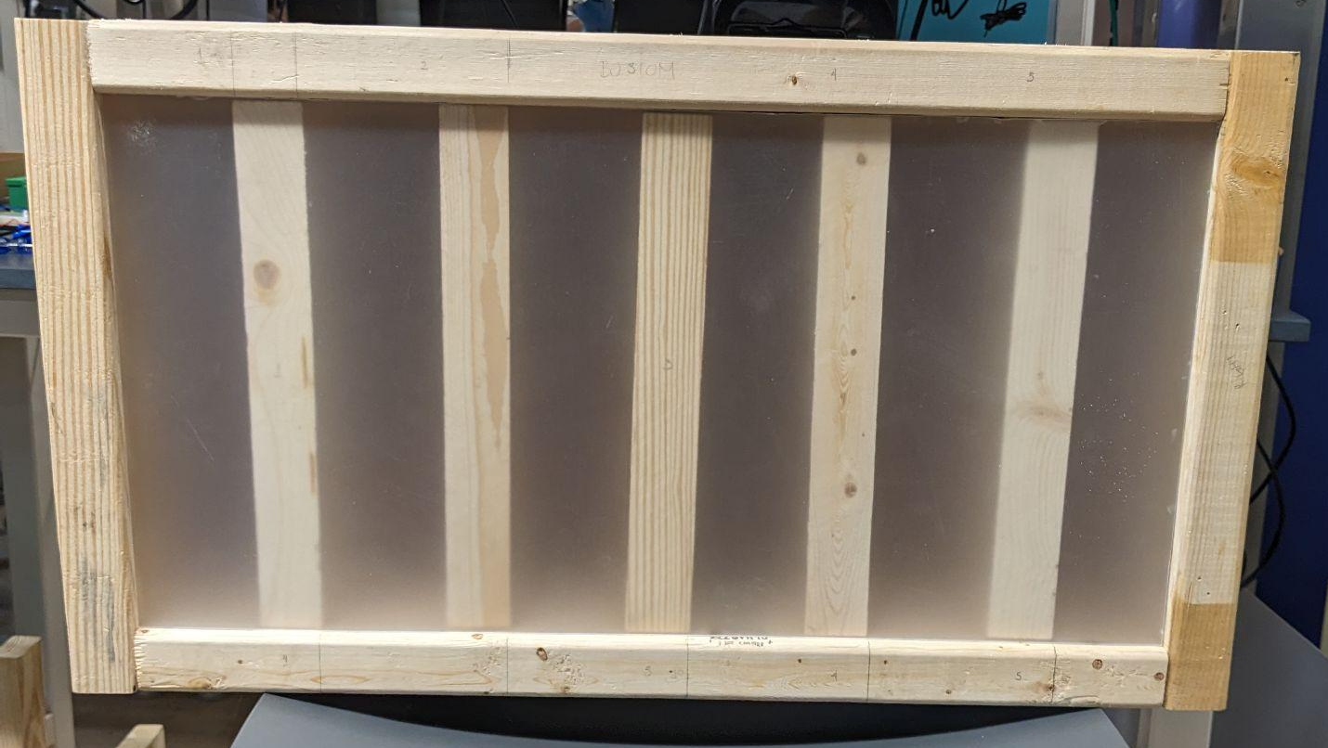
INDIVIDUAL CONTRIBUTIONS
GRAEME USMAN
Preliminary Research
Helped with finding relevant software, tools, and topics required for our project
Hardware Prototyping and Testing
TMUX prototyping
Microphone Amplifier Circuit
Final Schematic (w/ Anurag and Avik)
PCB Soldering and Debugging
Both final and testing PCBs
LED Fixture Construction

Slide 8
INDIVIDUAL CONTRIBUTIONS
Avik Wadhwa
Preliminary Research and Prototyping
Setup of initial schematic – component symbols, footprints
Iterations of prototyping circuitry and developing schematic for several components
Initial LTspice simulations for Audio circuitry (w/ Kahaan)
Final Schematic (w/ Anurag and Graeme)
Final Firmware Version
Mode switching software implementation
Implementing functionality to perform FFT on audio samples and frequency isolations ( w/ Kahaan and Anurag)
Debugging Issues and developing
PCB Development
Development of PCB – planes, layers, traces; based on guidelines from datasheet and Joe (!)
Fine tuning PCB based on requirements, and debugging issues (w/ Anurag)
3D Modelling for packaging the PCB (w/ Kahaan)

Slide 9
INDIVIDUAL CONTRIBUTIONS
Kahaan Patel
Preliminary Research and Prototyping
Generating a sample android application using online app simulator
Comprehending services needed to configure Bluetooth on ESP32 and Android Respectively
Initial LTspice simulations for Audio circuitry (w/ Avik)
3D Modelling for packaging the PCB (w/ Avik)
Final Firmware Version
Bluetooth Functionality
Implementing functionality to perform FFT on audio samples and frequency isolations ( w/ Avik and Anurag)
Implementing Light show post FFT isolation (w/ Anurag)
Android Application
Implementing Bluetooth Class for connection
Basic UI for Android Application
Notes:
Kahaan

Slide 10
PROJECT DEMONSTRATION
PSSC #1: The ability to reduce noise on analog inputs through the use of a 1-D Gaussian Filtering algorithm.
PSSC #2: The ability to control and configure multiple connected LED devices through an in-built Bluetooth module that connects with an Android app.
PSSC #3: The ability to amplify and filter analog input of the microphone using a sequence of operational amplifiers.
PSSC #4:The ability for the user to toggle between input modes by using multiplexed external controls. These modes will be Microphone (default), AUX-in, and Bluetooth.
PSSC #5:The ability to drive multiple WS2812B LED strips with PWM signals and reactively display patterns in response to audio signals.
Stretch Goal #1: The ability to isolate frequencies using the FFT algorithm.
Notes:
Anurag

Slide 11
Questions?
Notes:
All

